Slide 1
In-Memory Database Platform for Big Data Help you to tame the BIG DATA
Jordan Cao - SAP HANA - Technology Marketing
Uddhav Gupta - SAP HANA – Solution Management
June, 2013

Slide 2
Safe Harbor Statement
The information in this presentation is confidential and proprietary to SAP and may not be disclosed without the permission of SAP. This presentation is not subject to your license agreement or any other service or subscription agreement with SAP. SAP has no obligation to pursue any course of business outlined in this document or any related presentation, or to develop or release any functionality mentioned therein. This document, or any related presentation and SAP's strategy and possible future developments, products and or platforms directions and functionality are all subject to change and may be changed by SAP at any time for any reason without notice. The information on this document is not a commitment, promise or legal obligation to deliver any material, code or functionality. This document is provided without a warranty of any kind, either express or implied, including but not limited to, the implied warranties of merchantability, fitness for a particular purpose, or non-infringement. This document is for informational purposes and may not be incorporated into a contract. SAP assumes no responsibility for errors or omissions in this document, except if such damages were caused by SAP intentionally or grossly negligent.
All forward-looking statements are subject to various risks and uncertainties that could cause actual results to differ materially from expectations. Readers are cautioned not to place undue reliance on these forward-looking statements, which speak only as of their dates, and they should not be relied upon in making purchasing decisions.

Slide 3

Theme: Using Cloud to solve Big Data problems!

Slide 4










Big Data Offers New Opportunities Gain real-time insight from large volumes of a variety of data
Data Volume
Structured Data
Volume
Automobiles
Location- based Data
Large volumes (petabyte is normal)
!
Machine Data
Variety
Mobile
IMHO, it’s great!
Multiple data formats
Text Data
Velocity
Click Stream
7.9 Zettabytes
Fast collection, processing and consumption
Point of Sale
Value
Social Network
Competitive differentiator for business
1.8 Zettabytes
Customer Data
RFID
Smart Meter
1 Terabyte = 1024 Gigabytes
1 Petabyte = 1024 Terabytes
1 Exabyte = 1024 Petabytes
1 Zettabyte = 1024 Exabytes
2011
2015
Future
Notes:
Big Data technology is designed to extract value economically from very large volumes of a wide variety of data by enabling high velocity capture, discovery, and analysis.
As the amount of information continues to explode, organizations are faced with new challenges for storing, managing, accessing, and analyzing very large volumes of data. Today, it is not uncommon for large organizations to be dealing with volumes of data in the order of terabytes, exabytes, and zettabytes. According to IDC statistics, data is expected to grow by as much as 44 times over the next year to a staggering 35.2 zettabytes of data globally. Organizations face new challenges on how to store and process such large volumes of data in a timely and cost-effective manner.
In addition, the variety of data is changing enormously. According to Gartner, enterprise data will grow 650% over the next few years, with 80% of that data unstructured – meaning that the data explosion spans traditional sources of structured information (such as point of sales, shipping records, etc.), as well as non-traditional sources (such as Web logs, social media, email, documents, etc.). The diversity of data formats presents new challenges for gaining a complete and accurate view of information across the enterprise.
The velocity by which business users want access to relevant and timely information is increasing. Decisions based on information that is a week old must now be done in a day, and daily processes are reduced to minutes, seconds, and sub-seconds. As such, organizations face new challenges in increasing the speed by which they process data and deliver information to users to ensure competitive advantage.

Slide 5






New information sources driving data explosion
30M networked sensors nodes growing 30% y/y
Smart phones
growing 20% y/y
5B Mobile Phones
in Use
Facebook
800M active users
30B pieces of
content shared/month
Population of 7B
in 2011
You Tube
48 hours of video uploaded/minute
Notes:
And if these trends aren’t challenging enough, there is also an explosion of ‘Big Data’, flooding data into every area of the global economy.
In 2005, mankind created 150 exabytes (1 exabyte = 1B gigabytes = 10B copies of The Economist). In 2011, 1,200 exabytes will be created.
Social platforms like Facebook have over 800 million users, many interacting with products and services
The number of consumers with access to mobile devices exceeds the number of people with access to clean drinking water
Wal-Mart handles 1M customer transactions every hour, feeding 2.5 petabytes of data, the equivalent of 167 times the books in the Library of Congress.
Facebook houses 40B photographs.
Google processes 1 petabyte of search data every hour.
Decoding the human genome took 10 years when it was done initially in 2003. Now, it can be done in one week.

Slide 6














The Need for Efficient and Flexible Data Management
Combine different information access approaches: search, analysis, and exploration
No clear separation between transactional and analytical parts of the application
Leverage data of different degrees of structure and quality, from well-structured to irregularly structured to unstructured text data
Flexibly combine internal and external data based on business decisions to be made not the set of available integrated data
Are based on “real-time” current data and historical data
Need to support different form factors and deployment models: on-premise, on-demand and on-device
Execute
Optimize
Measure
Understand
External Sources
Notes:
Queries in transactional environments on the one hand are building the sums of already delivered orders, or are calculating the overall liabilities per customer. On the other hand, analytical queries require the immediate availability of operational data to enable accurate insights and real-time decision making.
Relational databases are falling short when it comes to data that has a very complex structure and unstructured, dynamic data, especially that which is associated with multimedia or social networking (advanced relationship analysis).
Relational databases are very good for processing data that is already well defined, but they can’t be used to discover the structure of data that isn’t.
Newer DBMSs require no predefined schema, can accept large amounts of loosely defined data, and can blend structured data with content.

Slide 7
The Challenge
Deep
Deep
Complex & interactive questions on granular data
Complex & interactive questions on granular data
Broad
High Speed
OR
Broad
High Speed
Big data, many data types
Fast response-time, interactivity
Big data, many data types
Fast response-time, interactivity
Real-time
Simple
Real-time
Simple
Recent data, preferably real-time
No data preparation, no pre-aggregates, no tuning
Recent data, preferably real-time
No data preparation, no pre-aggregates, no tuning
Notes:
With existing technologies, optimizing across all five dimensions in the spider diagram is not possible. Trade offs need to be made:
Do you want a report that provides broad and deep data analysis at a bearable speed? That is normally only doable after a lot of data manipulation like aggregation and normally has run times in the minutes, hours or days.
Alternatively, you could decide for a report design that is simple and fast, but it will normally not provide for any deep and broad insights.
Lastly, in both scenarios, real time updates are not possible per design; in a data warehouse environment they occur overnight via nightly batch jobs.
In summary, this shows todays typical tradeoffs between Broad and Deep analysis vx Speedy and Simple reports.

Slide 8
Challenge today!
Big Data Application
Transactional Database
Analytical Engine (DW/DM)
Search Engine
Predictive Engine
Planning Engine
Introduces Latency | Multiple copies of data |
Complex landscape | Scalability issues

Slide 9
The Challenge
Unify Transaction Processing and Analytics
Single System
Same Data Instance
Run Analytics in Real-Time
Run Analytics and Transactions at the “speed of thought”

Slide 10
Hardware Advances: Moore’s Law - DRAM Pricing
1980: Memory $10,000/MB
Memory Cost / Speed
2000: Memory $1/MB
2013: Memory $0.004/MB
Time

Slide 11

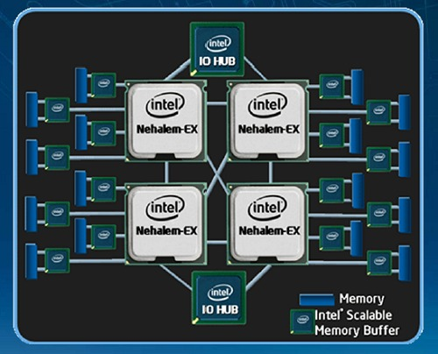

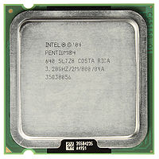
Hardware Advances: Moore‘s Law - CPUs
2002
2007
2010
2013
1 core
32 bits
4MB
2 cores
2 CPUs per server
External Controllers
8 cores -16 threads / CPU
4 CPUs per server
On-chip memory control
Quick interconnect
VM and vector support
64 bits; 256 GB - 1 TB
More cores, bigger caches
16 ... 64 CPUs per server
Greater on-chip integration (PCIe, network, ...)
Data-direct I/O
Tens of TBs
Images: Intel, Danilo Rizzuti / FreeDigitalPhotos.net
Notes:
From one core to multi-core, to multiple processors per servers, to multi-threaded cores, where we now have servers with up to 8 CPUs (with 24Mb caches each) and 160 threads!
Relentless technology progress by Intel, AMD, ARM and others, will lead to even bigger caches and cores. The name of the game is data-locality and parallelization. Just released “Sandy Bridge” generation for servers.

Slide 12
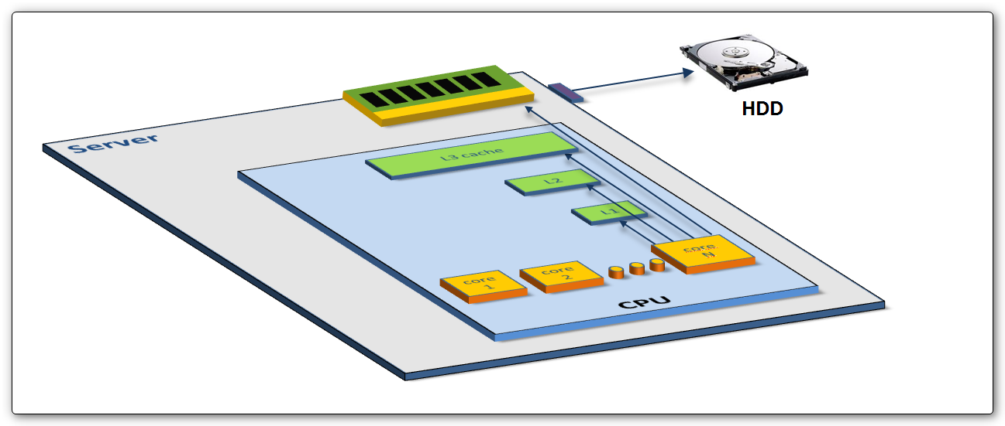
Software Advances: Build for In-Memory Computing Reduce Memory Access Stalls
In-Memory Computing: It is all data-structures (not just tables)
Parallelism: Take advantage of tens, hundreds of cores
Data Locality: On-chip cache awareness
Notes:
Critical slide!!!
Developing a database to solve these two critical challenges requires a careful design and development from the ground up of every aspect of the database. Relabeling an existing DB “in-memory” doesn’t do it. Carful optimizing for optimal cache utilization and for hundreds of parallel threads is what makes the difference, and allows HNA to reach the speeds I just discussed. I can’t over-emphasize hwo important solving these two challenges is to the performance of SAP HANA.

Slide 13
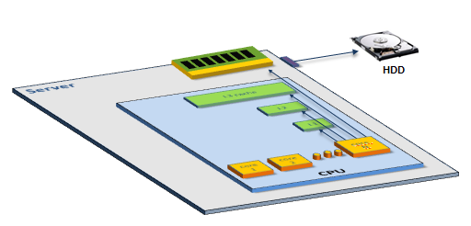
In-Memory Computing
CPU
Core
Core
L1 Cache
L1 Cache
0.5 NS
L2 Cache
L2 Cache
7.0 NS
Yes, DRAM is 100,000 times faster than disk, but DRAM access is still 6-200 times slower than on-chip caches
L3 Cache
15.0 NS
Main Memory
100 NS
Disk
SSD: 150K NS HD: 10M NS

Slide 14
In-Memory Computing enabling real-time access to big data*
“Big Data refers to the problems of capturing, storing, managing, and analyzing massive amounts of various types of data.
Most commonly this refers to terabytes or petabytes of data, stored in multiple formats, from different internal and external sources, with strict demands for speed and complexity of analysis.” [1]
In-Memory computing: “storing large blocks of data directly in the random access memory (RAM) of a server, and keeping it there for continued analysis.” [1]
Remove the disk IO bottleneck
No need to transfer data (push down computation)
[1] http://www.aberdeen.com/Aberdeen-Library/8361/RA-big-data-quality-management.aspx

Slide 15

SAP In-Memory Innovation
SAP HANA
In-Memory database and platform is a promising direction in the big data analytic world. SAP HANA is one most advanced solution to date. Big Data Congress invites us to give a comprehensive overview about this In-Memory computing technology by introducing SAP HANA to help you understand this new direction better.
Column Store
Parallelization
Scalability
Availability
Disaster Recovery

Slide 16
SAP in-memory innovations make the “New Way” a reality
Each technology works well on its own, but combining them all is the real opportunity — provides all of the upside benefits while mitigating the downsides
In-Memory
In-memory allows sophisticated calculations in real-time
Columnar storage increases the amount of data that can be stored in limited memory (compared to disk)
In-memory processing gives more time for relatively slow updates to column data
Optimized Calculation Engine
Column Database
Column databases enable easier parallelization of queries
Row buffer fast transactional processing
MPP optimized software enables linear performance scaling making sophisticated calculations like allocations possible
Massively Parallel Processing

Slide 17
SAP HANA: A New In-Memory Data Platform
One Foundation
for
OLTP + OLAP | Structured + Unstructured Data
Legacy + New Applications
Distribution | Single Lifecycle Management
Notes:
“New” In-Memory Platform
At the core of HANA, there is new in-memory DB engine supporting OLTP and OLAP in a single container but it is not just a database engine but a platform supporting building legacy and new kind of applications.
We pursue “single” container of data and applications with single lifecycle management. This contrasts with the approach of having multiple platforms and gluing these heterogeneous platforms.
After 40 years of leading enterprise app industry, we now have good understanding of applications, and better understanding of building simpler enterprise information management systems.

Slide 18
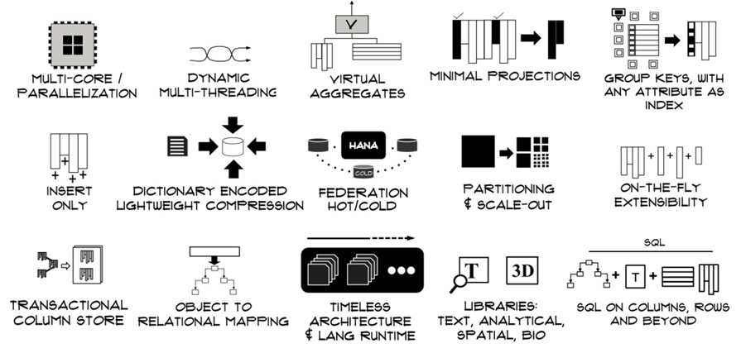
SAP HANA: Single System for Big Data Needs

Slide 19
SAP HANA: Column Store
Order | Country | Product | Sales
456 | France | corn | 1000
457 | Italy | wheat | 900
458 | Italy | corn | 600
459 | Spain | rice | 800
456 | France | corn | 1000
457 | Italy | wheat | 900
458 | Italy | corn | 600
459 | Spain | rice | 800
Typical Database
456
457
458
459
France
Italy
Italy
Spain
corn
wheat
corn
rice
1000
900
600
800
Σ
SELECT Country, SUM(sales) FROM SalesOrders
WHERE Product = ‘corn’
GROUP BY Country
SAP HANA: column order
Notes:
By accessing data in column-store order, you benefit immensely from simplified table-scan and data pre-caching. This can make all the difference in performance.

Slide 20
SAP HANA: Data Compression
Efficient compression methods (dictionary, run length, cluster, prefix, etc.)
Compression works well with columns and can speedup operations on columns (~ factor 10)
Because of compression, write changes into less compressed delta storage
Needs to be merged into columns from time to time or when a certain size is exceeded
Delta merge can be done in background
Trade-off between compression ratio and delta merge runtime
Updates into delta data storage and periodically merged into main data storage
High write performance not affected by compression
Data is written to delta storage with less compression which is optimized for write access. This is merged into the main area of the column store later on.

Slide 21
SAP HANA: Dictionary Compression

Slide 22
SAP HANA: Fast Scans + Simplified Data Model
Extreme fast scan speed per column
High compression leads to optimal data locality => high in-memory scan speed
Each attribute can be used as an index (without the overhead of updating index trees)
Full column scans and joins are extremely fast
Fast on-the-fly aggregation over columns
no need to materialize aggregates
simplified database schema
eliminates risk of inconsistency
faster write operations (no lock on aggregates)
simpler application code

Slide 23
SAP HANA: Temporal Tables (History Columnar Tables)
Column “ID” (primary key)
Column “Description”
Column “Size”
System Attributes (commit IDs)
Row
Value
Value
Value
Valid From
Valid To
⁞
102
12345
Shirt, blue
Medium
456
995
⁞
235
12345
Shirt, blue
Large
996
∞
⁞
Update T1 set Size=‘Large’ where ID=‘12345’
All Updates and Deletes are handled as Inserts

Slide 24
SAP HANA: Multi-Core Parallelization

Slide 25
SAP HANA: Single Instruction Multiple Data (SIMD)
Scalar processing
traditional mode
one instruction produces one result
SIMD processing
with Intel® SSE(2,3,4)
one instruction produces multiple results
SOURCE
SOURCE
127
0
X
X4
X3
X2
X1
Scalar OP
SSE/2/3 OP
Y
Y4
Y3
Y2
Y1
DEST
DEST
XopY
X4opY4
X3opY3
X2opY2
X1opY1
Notes:
The goal is to take scalar code (on left) and turn it into vector code (on right). This is at the heart of using as much SIMD HW as is available .

Slide 26
SAP HANA: Single Instruction Multiple Data (SIMD)
SSE Operation
128-bit wide with Intel® SSE(2,3,4)
2 64-bit integer ops/cycle
4 32-bit integer ops/cycle
8 16-bit integer ops/cycle
16 8-bit integer ops/cycle
256-bit with AVX (Ivy Bridge)
512-bit with Haswell
SOURCE
127
0
X4
X3
X2
X1
SSE2 OP
Y4
Y3
Y2
Y1
DEST
CLOCK
CYCLE 1
X4opY4
X3opY3
X2opY2
X1opY1
Vector-Processing Unit built-in standard processors
Notes:
NGMA can issue 3 integer operations per clock, vs NetBurst’s 4. But, the power dissapation to issue 4 per clock was high, and you could only issue 4 per clock under limited circumstances. You can issue 3 per clock much more often with NGMA, thus integer performance is generally better on NGMA.
3 SIMD units vs 2. Also, NGMA’s SIMD units are 128 bits wide (vs 64-bits on NetBurst). And you can issue 3 SIMD instructions per clock with NGMA vs 1 per clock on NetBurst.
Same number of FP units, but with NGMA you can issue 2 Floating Point instruction per clock (FP Add + FP Div or Mult), vs only 1 with NetBurst.

Slide 27
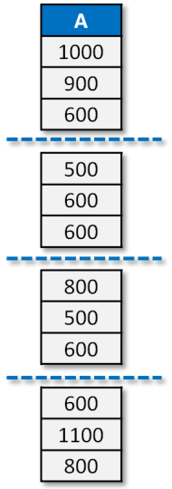

SAP HANA: Parallelization at All Levels
user1
user-n
Multiple user sessions
Concurrent operations within a query (… T1.A … T2.B…)
Data partitioning on one or more hosts
Horizontal segmentation, concurrent aggregation
Multi-threading at Intel processor core level
Vector Processing
scan A
scan B
partition A1
host 1
host 2
host 3

Slide 28
SAP HANA: Query Parallelization
Concurrent users
Concurrent operations within a query
Data partitioning, on one host or distributed to multiple hosts
Horizontal and vertical parallelization of a single query operation, using multiple cores / threads
Transparent to app developer
quant.
150
60
100
45
75
84
96
162
45
366
type
43
12
12
33
33
12
32
43
12
33
sales
$1000
$900
$600
$800
$500
$750
$600
$600
$1100
$450
$2000
core3
core4
core1
core2
Notes:
When your tables are already stored as columnar tables and since it is already vertically partitioned, you can also assign each column to different cores for parallel execution. This is transparent to the users when they execute the queries.

Slide 29
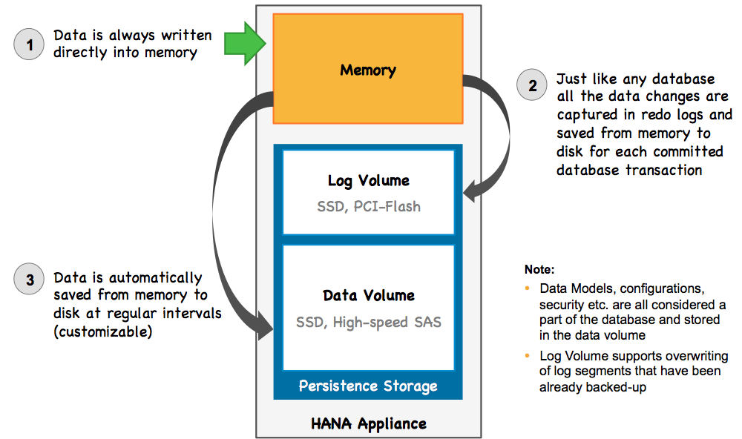
SAP HANA: Persistence Layer
Notes:
Lets now talk about how data is written to disk during a transaction.
During a transaction, insert/update is written to delta storage. And synchronously, the data change is written to the persistence layer log volume for each committed transaction. This is what makes hana ACID compliant.
At the same time, the changes in the delta storage will asynchronously move to the main storage.
After savepoint, it will save the data to disk asynchronously and create a snapshot.

Slide 30


SAP HANA: Scalability Scales from very small servers to very large clusters
Single Server
2 CPU 128GB to 8 CPU 1TB
Scale Out Cluster
2 to n servers per cluster
Largest certified configuration: 16 servers
Largest tested configuration: 100+ servers
Support for high availability and disaster tolerance
Cloud Deployment

Slide 31
SAP HANA: Multi-tenancy
Application ABC
Application ABC
Application XYZ
Application ABC
AS ABAP XYZ
SAP HANA
SAP HANA
SAP HANA
<HDB>
<HDB>
<HDB1>
<HDB2>
Schema ABC
Schema ABC
Schema ABC
Schema XYZ
Schema XYZ
Non-Production Only
SAP HANA Supports building Multi-tenant applications

Slide 32
SAP HANA: Scale Out
Scale Out Landscape
N servers in one cluster
Each server hosts a name and index server
One server hosts a statistics server
Scale Out Capabilities
Large tables distributed across servers
Queries can be executed across servers
Distributed transaction safety
Maximum Scale Out
Up to 56x1TB certified configuration
HW vendors certify larger configurations
6 standard servers
Server 1
32/40 cores 512 GB
Server 2
32/40 cores 512 GB
Server 3
32/40 cores 512 GB
Server 4
32/40 cores 512 GB
Server 5
32/40 cores 512 GB
Server 6
32/40 cores 512 GB
= 1 Supercomputer
192/240 cores 3 TB

Slide 33
SAP HANA: Data Partitioning
Tables can be partitioned, and distributed across multiple hosts
Huge tables; cross machine parallelization
Hash, Range, Round Robin Partitioning
All HANA hosts act as SQL servers; distributed execution
Planned for multi-tenant deployments (future)
Select * from table where Color = “red”
Host 1
Product | Group | Color
10 | A | red
20 | B | blue
30 | A | green
40 | A | red
50 | C | red
60 | A | red
Product | Group | Color
10 | 1 | 3
30 | 1 | 2
40 | 1 | 3
60 | 1 | 3
Select * from table where Group = “A”
Host 2
Product | Group | Color
20 | 2 | 1
50 | 3 | 3
33
Notes:
Partitioning is useful for fast query processing, You can partition the tables across multiple hosts. Splitting up the tables into multiple partitions can also help improve the delta merge operation.
We support the following partitioning methods:
1- hash – which will evenly distribute the data across your partitions
2- Range – is where you can give it a date range to store it in separate partition – 2011 in 1 partition, 2012 in second partition, etc.
3- list – defines how rows are matched to the partitions ex: list ny, nj, and PA as one partition, ca, az and nevada as second partition.

Slide 34
SAP HANA: High Availability
High Availability configuration
N active servers in one cluster
M standby server(s) in one cluster
Shared file system for all servers
Services
Name and index server on all nodes
Statistics server (only on active servers)
Failover
Server X fails
Server N+1 reads indexes from shared storage and connects to logical connection of server X
Server 1
Server 2
Server 3
Shared Storage
Server 4
Server 5
Server 6
Cold Standby Server

Slide 35
SAP HANA: High Availability
1. Storage replication (storage based mirroring)
SAP HANA disk areas controlled by storage technology
First synchronous implementation
Afterwards asynchronous implementation following (planned)
2. System replication (WARM Standby) DATA and LOG content is continuously transferred to secondary site under control of SAP HANA database
Fast switch-over times because secondary site has preloaded DATA
First synchronous implementation
3. System replication (HOT Standby) DATA content is only initially transferred to secondary site, afterwards continuous LOG transfer and LOG replay on secondary site
LOG is provided to secondary site on transactional basis (COMMIT) controlled by SAP HANA database (including initial DATA transfer)
Fastest switch-over times, sec. site preloaded and rolled forward on COMMIT basis

Slide 36
Initial Proof Points
460 Billion Records
50 TB of data
No Indexes
No Aggregates
0.04 secs
1.8M Dunning Items
Multiple Complex calculations
13 secs (v/s 77 minutes)
Complex Gnome Analysis
20 mins (v/s 3 days)
Analytics using BOBJ + HANA
Accelerating Business Processes
Predictive + HANA
2 Billion scans / second / Core
1.5 TB / hr Data loads
12,000x Average Peformance Improvement

Slide 37
Database Landscape
Relational
Multi- Dimensional
NoSQL
Tabular
Multi- Dimensional
Sparse Matrix
Dictionary
Triple
Hierarchical
Row
Columnar
Multi- Dimensional
Big Table
Key Value Store
Graph
Document or XML
ACID
ACID
BASE = Eventually Consistent
Oracle Sybase ASE Teradata
Sybase IQ GreenPlum Netezza
IRI Express Oracle Essbase Microsoft
HBase Cassandra Big Table
MemCache Casandra AeroSpike
Neo4J Alegro Graph InfiniteGraph
MongoDB MarkLogic CouchDB
Read Only Reporting w/ Hive
HBase
MR+ Hadoop
HANA
HANA
HANA
HANA
HANA*
HANA
Consistency
CAP Theorem
CA
CP
* Not yet available
Availability
AP
Partition Tolerance

Slide 38
What is inside HANA?
BICS
NetWeaver BW
SAP BOBJ
ODBO
MS Excel
3rd Party OLAP Tools
MDX
BICS
JSON / XML
HTTP
RESTful services
OData Compliant
ODBC / JDBC
3rd Party Apps
3rd Party Tools
OLAP
Parallel Execution
Unstructured (Text)
SQL
Query Federation
IQ / ASE
Teradata / Oracle
Hadoop
Out
Scripting Engine
ACID Compliant Database
In-Memory
Column Store
XS App Server
In
Business Function Library
“R” HS Integration
“R”
HANA Studio
Predictive Analysis Library
Spatial / Geospatial
Data Services
Replication Services
Batch Transfer
SAP & Non-SAP
Extensive Transformations
Structured & Unstructured
Hadoop Integration
Near Real Time
Non-SAP
ESP
Notes:
Big building 1910
Basketball hoop – 10 feet
Ratio of 106M to 4.9k
Memory access is 1M – 10M times faster than disk. In the past memory was so expensive that database vendors optimized for disk. However, with memory costs dropping so dramatically over last 20 years, it’s not possible to harness the power of in-memory computing.

Slide 39
In-Memory Database Platform for Big Data SAP HANA

Slide 40










Big Data Processing Framework
Data Scientists / Business Analysts
Middle Managers
Frontline Workers
Executives
Customers
Engage
BI Tools
Analytic Tools, Custom Data Analysis Applications
Business Applications & Processes
Process
Data Mining / Predictive Analysis
SAP In-Memory
Information Views
Store
Business Intelligence
Real-time Database
EDW / Data Marts
Insight Discovery
Unstructured Data Store
Real-time Value
Ingest
ETL, Data Quality
Text Analysis
Real-time Loading
Transactional Databases
Other Application/ Data Sources
Social Media Content
Unstructured Content
Machine Data
00110101
10010110 01001101
Notes:
NOTE: This is not meant to a physical architecture of what customers would deploy. However, it does capture the critical components that make up a Big Data landscape.

Slide 41
In-Memory Database and Platform for Big Data SAP Real-time Data Platform Optimized for Big Data applications
3rd Party
BI Clients
SAP Business Suite
SAP Business Warehouse
SAP Big Data Applications
SAP Analytics
SAP
Mobile
Custom Apps
SAP NetWeaver (On Premise / Cloud)
SAP Real-time Data Platform
Open Developer API’s and Protocols
SAP Sybase SQLA
SAP HANA Platform
SAP Sybase ASE
SAP Sybase IQ
MPP
Scale-Out
HADOOP
NoSQL
Common Modeling
Sybase PowerDesigner
SAP Sybase ESP
Common Landscape Management
SAP Sybase
Replication Server
SAP Data
Services
SAP MDG, MDM, DQ
Enterprise Information Management

Slide 42
In-Memory Database Platform for Big Data SAP HANA
Ingest: Help you load/access big data from different data sources
ETL process
Real-Time Replication
Data Virtualization

Slide 43

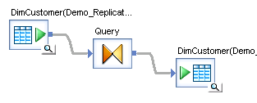





Overview: Data Provisioning with SAP HANA
SAP Business
Suite
SAP LT Replication Server
Trigger Based, Real Time
DB Connection
SAP BW
ETL, Batch
Log Based
SAP Data Services
ODBC
ECH
HANA
SAP Sybase Replication Server
Non SAP
Data Sources
ODBC
Trading & Order
Management Systems
Event Streams
SAP Sybase Event Stream Processor
ODBC
Network Devices-
wired/wireless
Data Synchronization
SAP Sybase SQL Anywhere
ODBC/ JDBC/ oData
Data Sources
Your own Applications

Slide 44



SAP Sybase Replication Server
Provide real time, log-based, transactional replication for HANA
HANA
Source DB
ECH
WAN
ECH
HANA ODBC
SAP Sybase ASE
Oracle
MS SQL
IBM DB2/UDB
SAP Sybase Replication Server for HANA
SAP Sybase Replication Server for HANA
HANA
LAN
HANA
Log-based Heterogeneity support: Supports Log-based ASE, Oracle, MS SQL and IBM DB2/UDB replication for low-impact and non-intrusiveness of production system
Express Connector for HANA (ECH): SRS dynamically loads ECH library to leverage native HANA bulk capability for better performance
Heterogeneous materialization
Preserve Transactional Consistency
Flexible Deployment topology
Data Assurance support
Notes:
Non-intrusive transaction capture (log-based)
Flexible transformation of data between sources and targets
Efficient routing across networks to reduce bandwidth requirement
Real-time synchronization across heterogeneous databases

Slide 45





SAP Data Services
SAP Data Services (DS) is suited for Data Integration (Batch), with HANA optimized capabilities for Transforming, Cleansing* and Integrating (bulk or delta) structured and unstructured* data from many different Sources (SAP and non-SAP) to the Target (SAP HANA).
Native support for 40+ sources and interfaces
SAP Business Suite, Success Factors, RDBMS, 3rd party Apps
HANA Studio
SAP HANA
SAP Data Services:
Connectivity
Transformations
Quality
Hadoop/Hive
Data Services
SAP in-memory computing
Text and Binary Files,
XML, Excel, JMS,
Web Sources
* Data Integrator (for ETL only) is included with most HANA packages. A full Data Service license is required to utilize Data Quality and Text Data Processing.

Slide 46








SAP Sybase Event Stream Processor
INPUT STREAMS
Studio (Authoring)
OUTPUT INFORMATION
Sensor data
SAP Sybase Event Stream Processor
?
Dashboard
Transactions
Application
Message Bus
Events
SAP HANA
Reference Data
Unlimited number of input streams
Incoming data passes through “continuous queries” in real-time
Output is event driven and publish alerts or triggers response process
Scalable for extreme throughput, millisecond latency
High speed smart capture
ESP can query HANA to provide context for processing incoming events
Notes:
High speed smart capture: ESP can apply logic to transform, filter, aggregate, enrich incoming event streams and capture data in HANA

Slide 47
Ingest Examples Of Event Processing
Notify / Observe
Observe anomalies and take action
Selective Information Aggregation
Get right information, at right periodicity, at right granularity
Real-Time Analytics
Capture data and perform analysis for driving operational decisions
Utilize historical data (or knowledge of data ranges) to identify anomalies
Utilize filtering, sampling of incoming data, aggregation to summarize/synthesize data
Pattern Detection
Identify patterns in incoming data streams and take action
Utilize combination of analytics on data stream with comparing historical values to drive decisions e.g., is average in last 5 minutes > historical threshold?
Utilize and search for patterns in one or more streams and take action if pattern is seen
Look at the stream of events watching for pre-defined patterns or trends over a period of time, and generate an alert if the required pattern (complex event) is detected:
Pattern detection: Pump pressure is increasing while output is decreasing
Information Aggregation: More than 100 parcels are delayed for 10mins
Real-time Analytics: A credit card has been used in 3 geographically separate locations in the last 20 minutes

Slide 48




Rapid data provisioning with data virtualization
Application
Modeling and Development Environment
Data-Type Mapping & Compensate Missing Functions in DB
SAP HANA
Merge Results
Application
SELECT from DB(x)
SELECT from DB(y)
SELECT from HIVE
One SQL Script
Virtual Tables
Modeling
Environment
Modeling
Environment
Modeling
Environment
Supported DBs as of SPS6: Sybase ASE, IQ Hadoop/HIVE, Teradata
Remote data access like “local” data
Smart query processing leverages remote database’s unique processing capabilities by pushing processing to remote database; Monitors and collects query execution data to further optimize remote query processing.
Compensate missing functionality in remote database with SAP HANA capabilities.
Accelerate application development across various processing models and data forms with common modeling and development environment.

Slide 49
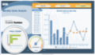
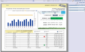

Hadoop Integration
Visualize HIVE / HANA data
Integration at ETL layer
Data Services provides bi-directional Hadoop connectivity: HIVE, HDFS, Push down entity extraction to Hadoop as MapReduce jobs
Direct HANA-Hadoop connectivity
Proxy Table (HANA SP6)
Virtual HANA table to federate a Hive table at query time
HCatalog integration (HANA SP6)
Leverage Hadoop metadata to improve query performance, e.g. partition pruning in Hadoop before executing query
SAP BI connectivity
SAP BOBJ multi-source Universe can access Hadoop HIVE
SAP HANA
Load results into HANA
(Data Services)
Smart Query Access
(Data Virtualization)
Loading data for Pre-process
Hadoop
Log files
Unstructured data

Slide 50
In-Memory Database Platform for Big Data SAP HANA
Store: Help you to model, manage, and pre-process different type data
Unstructured Data
Geospatial Data

Slide 51
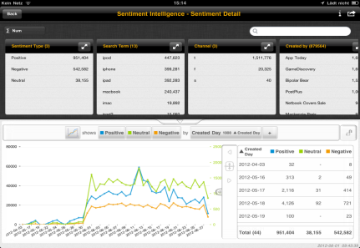
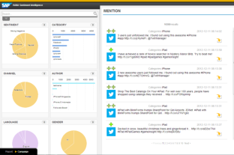
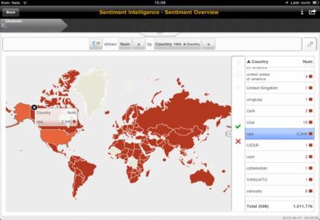














Deal with Data Variety of Big Data
Advanced text analytics
Analyze text in all columns of table and text inside binary files with advanced text analytic capabilities such as: automatically detecting 31 languages; fuzzy, linguistic, synonymous search, using SQL.
Structure unstructured data
Use advanced text analytics, such as sentiment fact extraction, to structure unstructured data.
Streaming data
Analyze streaming data from integrated ESP in combination with data in SAP HANA.
Geospatial data
 | Embed sentiment fact extraction in same SQL
 | Embed geospatial in same SQL
 | Embed fuzzy text search in same SQL
 | CREATE FULLTEXT INDEX i1 ON PSA_TRANSACTION( AMOUNT, TRAN_DATE, POST_DATE, DESCRIPTION, CATEGORY_TEXT ) FUZZY SEARCH INDEX ON SYNC; SELECT SCORE() AS SCR, * FROM "SYSTEM"."PSA_TRANSACTION" WHERE CONTAINS (*, 'Sarvice', fuzzy) ORDER BY SCR DESC;
SQL
SAP HANA
Any Data
Customer Data
RFID
Smart Meter
Mobile
Point of Sale
Geospatial Data
Machine Data
Connected Vehicles
Structured Data
Click- stream
Social Network
Text Data

Slide 52
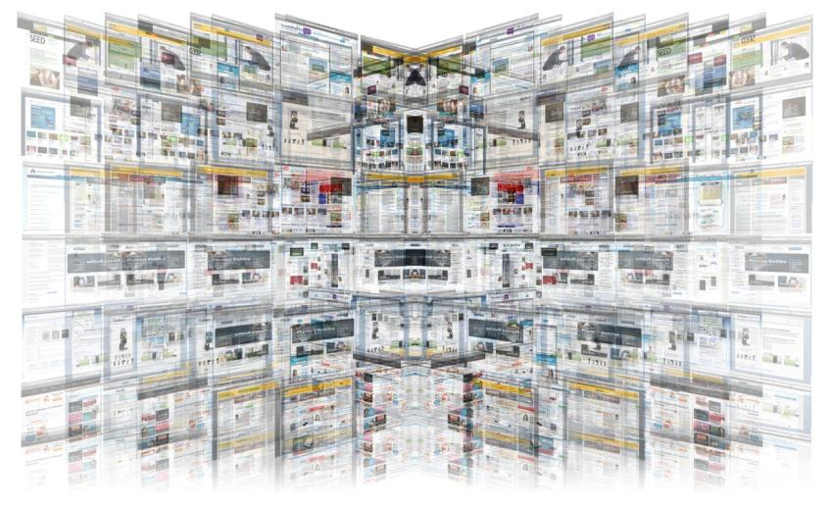
Hidden Value in Text
80% of enterprise-relevant information originates in “unstructured” data:
Blogs, forum postings, social media
Email, contact-center notes
Surveys, warranty claims
Notes:
A lot of knowledge and value are embedded in the huge volume of data. After discovering those values, we can use them to improve our life from multiple directions, such as we can get better profit margins because you know better about what customers want. For example, SAP customer, university of Kentucky found one percent student retention rate increase can generate about 1M revenue.
You can have a more efficient operations because you can fast find the bottle neck from the operational data. Or you can even define a new business model because you see something you never know before.
A McKinsey study has found huge potential for big data analytics with metrics as impressive as 60% improvement in retail operating margins, 8% reduction in (U.S.) national healthcare expenditures, and $150 million savings in operational efficiencies in European economies.
- Source: “Big Data: Next frontier for innovation, competition, and productivity,”

Slide 53
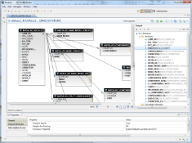



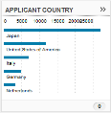
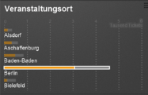

Text Search & Text Analysis Application
Create Model
Use SAP HANA Studio to define the search data model and configure the search behavior
Create Full-text Index
Use SAP HANA Studio to create full-text indexes for search (linguistic, fuzzy…), file filtering, binary text (.pdf, .doc) analysis, support 31 languages, TF-IDF score, and optionally run Text Analysis
Run Text Analysis
Extract salient information from text (Linguistic Markup, Entity & Sentiment Extraction)
Configure App
Use SAP HANA Info Access toolkit to define layout and data for the App
Consume Data
Search on Text and/or filter, analyze, and perform advanced analytics on text analysis table output

Slide 54
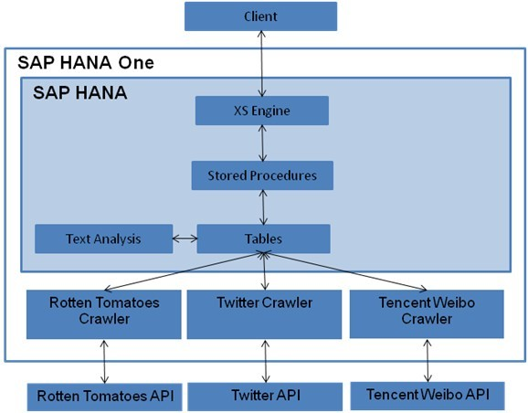
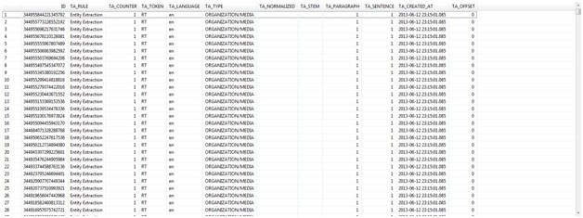
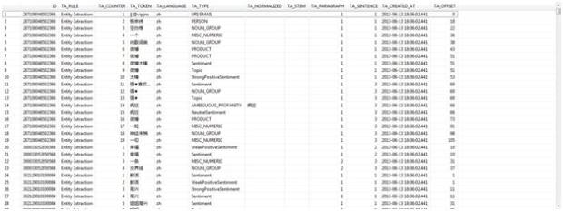
Example Text Analytic Codes
CREATE FULLTEXT INDEX TWEET_I ON TWEET (CONTENT) CONFIGURATION'EXTRACTION_CORE_VOICEOFCUSTOMER' ASYNC FLUSH EVERY 1 MINUTES LANGUAGE DETECTION ('EN') TEXT ANALYSIS ON;
CREATE FULLTEXT INDEX TWEET_ZH_I ON TWEET_ZH (CONTENT) CONFIGURATION'EXTRACTION_CORE_VOICEOFCUSTOMER' ASYNC FLUSH EVERY 1 MINUTES LANGUAGE DETECTION ('ZH') TEXT ANALYSIS ON;

Slide 55



Geospatial Data Competing in today’s marketplace
80%
15B
90%
of all data contains some reference to geography*
internet connected devices by 2015**
of all mobile devices are GPS-enabled*
* Franklin, Carl and Paula Hane, “An introduction to GIS: linking maps to databases,” Database. 15 (2) April, 1992, 17-22. ** Cisco’s Internet Business Solutions Group (IBSG), “The Internet of Things”

Slide 56





Spatial adds a “new dimension” to big data Spatial processing with SAP HANA
Provides the ability to answer an entirely new set of business questions with an additional location dimension
Goes beyond just postal/zip codes for precise location intelligence
Processes spatial data types and business data rapidly to deliver results to applications and BI tools in the form maps, reports and charts
GIS (Geospatial Information Systems) are becoming more common in most organizations and industries. The benefits include:
Cost Savings and Increased Efficiency
Better Decision Making
Improved Communication
Better Record Keeping
Managing Geographically
Application Areas
Assets and Work Management
Industries
Business Intelligence
Financial and Insurance Services
O&G, Manufacturing & Utilities
Spatial Processing with SAP HANA
CIS/CRM
Retail and Consumer Products
Public Sector & Healthcare
Mobility
Real Estate
Telecommunications
Environmental Health and Safety

Slide 57
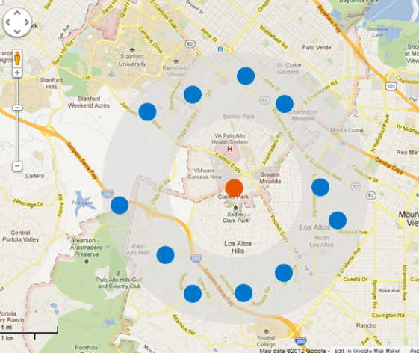
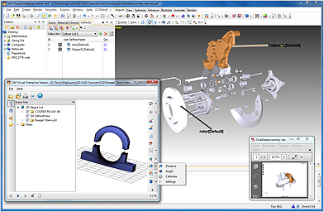
What is a spatially enabled database? Key capabilities delivered in SAP HANA
Store, process, manipulate, share, and retrieve spatial data directly in the database
Process spatial vector data with spatial analytic functions:
Measurements – distance, surface, area, perimeter, volume
Relationships – intersects, contains, within, adjacent, touches
Operators – buffer, transform
Attributes – types, number of points
Store and transform various 2D/3D coordinate systems
Process vector and raster data
Comply with the ISO/IEC 13249-3 standard and Open Geospatial Consortium (1999 SQL/MM standard)
Multi-polygon
point
line
polygon

Slide 58
In-Memory Database Platform for Big Data SAP HANA
Process: Help you analyze big data to discover deep insight
Predictive Analytic Library
R integration

Slide 59
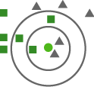

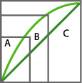


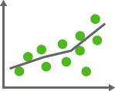





SAP HANA Predictive Ecosystem
Apps
Apps
SQL Script
(Optimized Query Plan)
KNN classification
Predictive
R
Logic
Logic
K-means
ABC classification
R Engine
R-scripts
PAL
Weighted score tables
Pre Process
Pre Process
Pre Process
Unstructured
Associate analysis: market basket
Geospatial
Virtual Tables
Regression
OLAP
Unstructured
C4.5 decision tree
Accelerate predictive analysis and scoring with in-database algorithms delivered out-of-the-box. Adapt the models frequently.
Execute R commands as part of overall query plan by transferring intermediate DB tables directly to R as vector-oriented data structures.
Predictive analytics across multiple data types and sources. (e.g.: Unstructured Text, Geospatial, Hadoop)
Notes:
Backend Tools:
HANA Predictive Analysis Library (PAL)
PAL is a set of predictive analysis functions written in C++ and executed in HANA.
HANA - R Integration
Through the R integration solution, developers can leverage open source R’s 3000+ external packages to perform a wide-range of data mining and statistical analysis.
Frontend Tools:
SAP Predictive Analysis
Rich UI for modeling workflow and visualization.
Expertise:
SAP Performance and Insight Optimization; Partners
Applications:
Retail: Affinity insight; Demand Signal Management
Utilities: Smart Meter analytics
CRM customer segmentation
Key Messages:
1) Existing implantations of predictive and planning algorithms are executed with the data copied from the OLAP system to the dedicated servers. Results are consolidated from these dedicated servers into the application that end user uses. HANA can perform most of the commonly used predictive algorithms and planning functions in side database.
HANA provides Predictive Analytics Library (PAL) which includes algorithms such as K-means, C4.5 decision tree, KNN and Apriori. It supports applications in the categories - Clustering, Classification, Association, Time Series and Preprocessing.
Predictive analysis functions are written in C++, runs as part of database index server for better performance and supports parallelization. Predictive algorithms can be executed as part of script sever to reduce the risk of destabilizing database index server.
2) Complex predictive algorithms implemented in R Server can be significantly accelerated by
running R commands as part if overall query plan
transferring intermediate DB tables direcly to R as vector oriented structures
3) HANA planning engine executes the planning functions. It helps you define your action/budget plan based on existing data. SAP HANA integrates this feature and allows you to execute the formulas specified in the formula extension(FOX) language planning commands. They can modify data in memory without modifying the persistent data.
Supporting Details:
Predictive capabilities are becoming more and more important. As per Gartner, by 2016, 70% of the world’s most profitable companies will manage business processes by using real time predictive analytics or "extreme collaboration”. The predictive feature actually help you understand your business (supply/demand trend), your customer (usage behavior pattern), and so on.
Predictive algorithms are configurable with parameters. For example, in K-Means, number of iterations and kind of initialization method used can be configured.
Calculation view (mainly through normal SQLScript) can be used to perform preprocessing or filtering before or after invoking the predictive algorithms.
With the R integration project in SAP HANA, users can run R scripts transparently in the SAP HANA database environment. You can write R scripts yourself or invoke thousands of existing R external packages. You can leverage R to extend HANA’s data mining and statistic analysis capability through the SQLScript interface like a stored procedure. Or you can also use the SAP HANA database as a data source for open source R.

Slide 60
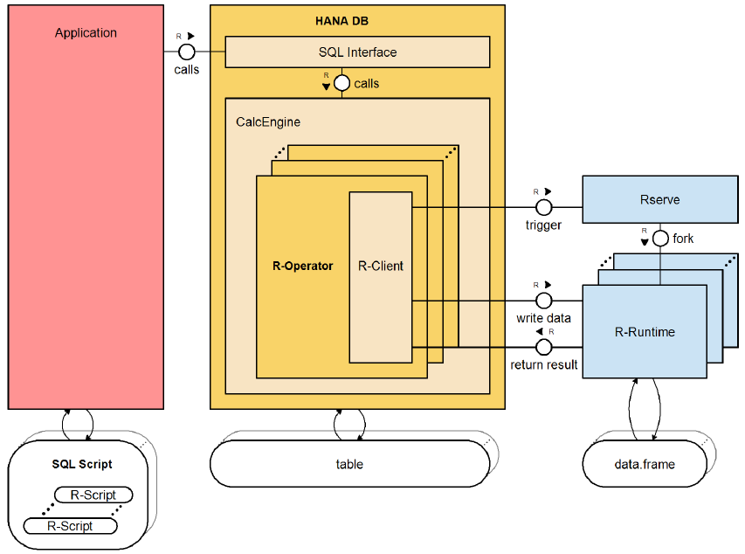
R Integration for SAP HANA
Embedding R scripts within the SAP HANA database execution
Enhancements are made to the SAP HANA database to allow R code (RLANG) to be processed as part of the overall query execution plan
This scenario is suitable when the modeling and consumption environment sits on HANA and the R environment is used for specific statistical functions
Sample Code in SAP HANA SQLScript
CREATE FUNCTION LR(
IN input1 SUCC_PREC_TYPE,
OUT output0 R_COEF_TYPE)
LANGUAGE RLANG AS'''
CHANGE_FREQ<-input1$CHANGE_FREQ;
SUCC_PREC<-input1$SUCC_PREC;
coefs<-coef(glm(
SUCC_PREC~CHANGE_FREQ,
family = poisson ));
INTERCEPT<-coefs["(Intercept)"];
CHANGEFREQ<-coefs["CHANGE_FREQ"];
result<-as.data.frame(
cbind(INTERCEPT,CHANGEFREQ))
''';
TRUNCATE TABLE r_coef_tab;
CALL LR(SUCC_PREC_tab,r_coef_tab );
SELECT * FROM r_coef_tab;
1
Send data and R script
3
Get back the result from R to SAP HANA
2
Run the R scripts

Slide 61
R Integration for SAP HANA Functionality Overview
R integration for SAP HANA enables the use of the R open source environment in the context of the HANA in-memory database
Allows the application developer to embed R script within SQL script and submit entire query to the HANA database.
As the plan execution reaches R codes, a separate R runtime is invoked using Rserve and input tables of R node passed to R process using improved data transfer mechanism.
Establishes a communication channel between HANA and R for fast data exchange
Improved data exchange mechanism supports transfer of intermediate database tables directly into vector oriented data structures of R.
Performance advantage over standard tuple-based SQL interfaces with no need for data duplication on the R server.

Slide 62
Predictive Analysis DEMO
Flu Trend Analysis based on Twitter Data
http://54.236.239.179:8080/FluAnalysis/index.jsp

Slide 63
In-Memory Database Platform for Big Data SAP HANA
Engage: Help you to visualize and communicate analysis result with users more efficiently
Explorer
Lumira
SAP BusinessObjects BI

Slide 64

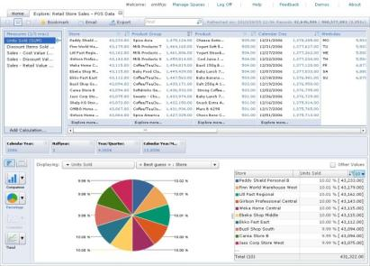
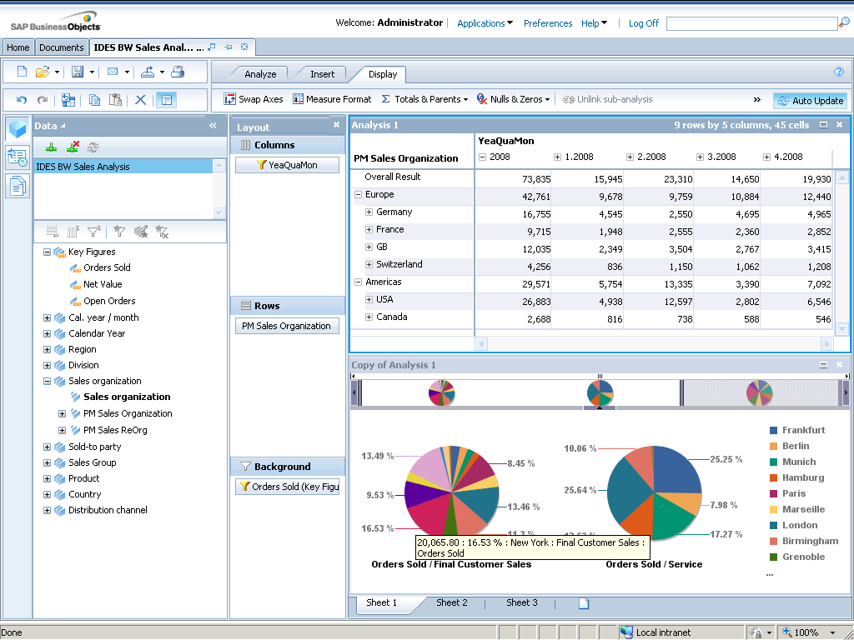
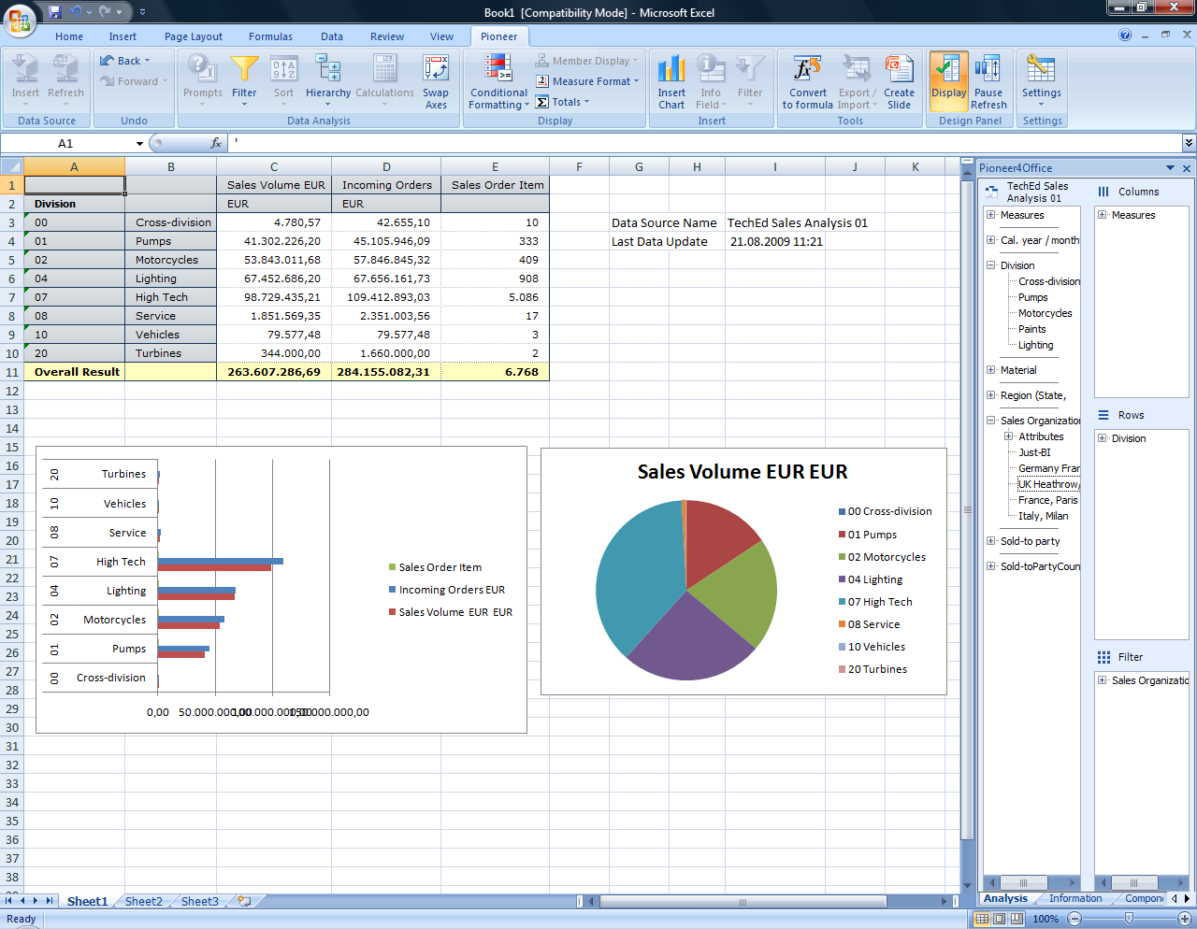
SAP BusinessObjects BI 4.x and HANA – Client tools Discovery and analysis
Capabilities in SAP BusinessObjects allow SAP HANA to be used as a data source for discovering and visualizing information.
Explorer
Native access to HANA analytical models
Explore analytic views or calculation views
One view per information space
Variables and input parameters support
SAP Lumira (Desktop & Cloud)
Native access to HANA analytical models
Visualize analytic views or calculation views
Analysis Office and Analysis OLAP
Direct access to HANA support includes the following:
Hierarchies, Navigation / drilldown
Filters: member selector (including search measure)
Sort by members
Swap axes
Calculated measures +,-,*,/
Input parameters
Support of multilingual information

Slide 65

Lumira on HANA Overview
Acquire, discover, share, explore & analyze HANA data modeled / uploaded from HANA Studio, Visual Intelligence or directly from Lumira Web
HANA native - hosted on the HANA Platform and Managed by HANA Studio administration console
Access from Lumira desktop, Lumira web & Mobile BI (tablet)
Lumira Desktop
Lumira Web
Lumira
Tablet
(MobI / Safari )
browser
Uploading, Exploring & Analyzing Hana Data
HANA In-memory platform
Lumira on HANA v1.0
HANA XS Engine (XSE)
HANA Studio
Calculation Engine
Security / IDM Services …
System Landscape
HANA data modeling
& Administration

Slide 66
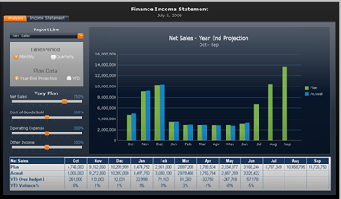
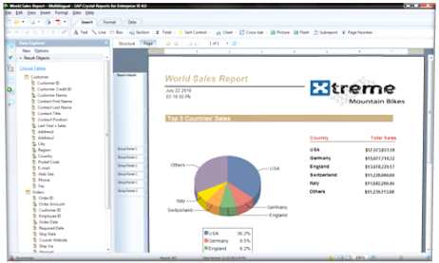
SAP BusinessObjects BI and HANA – Client tools Dashboards and apps
Support Build Dashboards and Apps:
Dashboards
Support for dashboards built on universe (UNX) giving access to:
Tables (column store) and SQL views
Analytic and calculation views
Design Studio
HANA application building including mobile support
Navigation on crosstab
Hierarchy support
Language dependency
Command editor
Initial view editor
Support Build Reports:
CR 2011 and CR 2008
Access to standard tables and views
Access to analytic and calculation views
CR for Enterprise
Support for HANA functionality exposed via semantic layer
Web Intelligence
Support for HANA functionality exposed via semantic layer
Query stripping on HANA universes

Slide 67
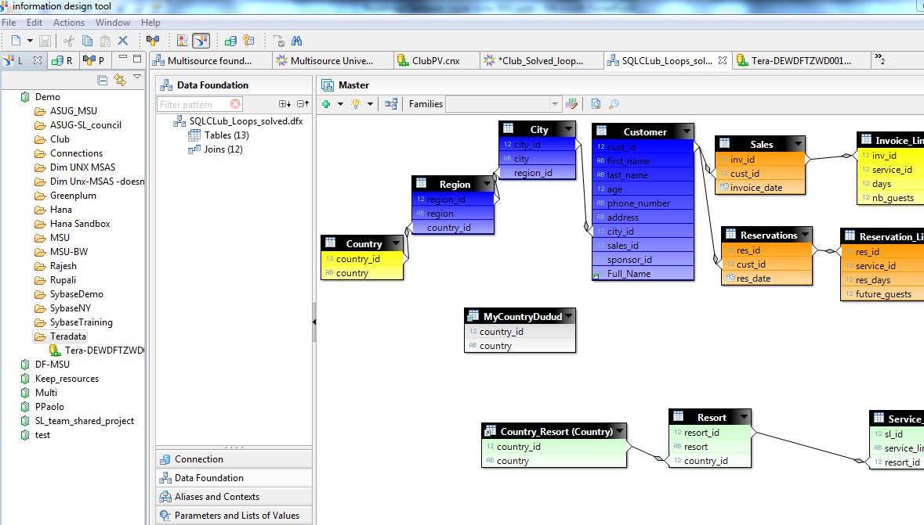
SAP BusinessObjects BI and HANA – Semantic layer Semantic layer
Support of SAP HANA by the semantic layer via relational universes (UNX) allowing SAP BusinessObjects BI suite to use SAP HANA as a data source
Relational universes
Support for relational universe format (UNX) via a JDBC or ODBC
Access to:
Tables (column store) and SQL views
Analytic and calculation views (JDBC only)
New SQL features in HANA are immediately available for universes, for example prompts and variables
Universes do not store data from HANA or add any performance overhead
Universes are just like any other client tool using SQL to access HANA - the latest data from HANA is sent to the client tool on query refresh

Slide 68

In-Memory Database Platform for Big Data SAP HANA One

Slide 69


Experience SAP HANA with SAP HANA One SAP HANA One = SAP HANA + Public Cloud
SAP HANA license + AWS infrastructure fees (appliance + storage)
Self-service, subscription-based on AWS
Build any kind of SAP HANA application or analytics, for proof-of-concept or production
Pay as you go
“
”
SAP HANA ONE … was just the right thing at the right time for us. With its user-friendly client interface and fast processing, people see numbers and charts within seconds, so big data is no longer formidable to them.
“How The Globe and Mail Builds More Accurate Marketing Campaigns Faster” in the October-December 2012 issue of insiderPROFILES (insiderprofiles.wispubs.com).

Slide 70

SAP HANA in the Cloud – related offerings Subscription pricing + productive use = SAP HANA One
SAP HANA Cloud
SAP HANA Developer Sandbox
SAP HANA One
SAP HANA Cloud Hosting
SAP HANA license: free
SAP HANA appliance:
Free
TBD
Share resources
Data visible to all users
SAP HANA license: $0.99/h
SAP HANA appliance:
$2.50/hr
Amazon CC 8XL
60.5GB of RAM
Use for productive use case
Max 30GB of data
Departmental use cases
OK to prototype w/option to move to production
SAP HANA license:
Bring Your Own License
Fully outsourced, no license
SAP HANA appliance:
Hosting on certified HW for a monthly fee
Single-tenant, bare-metal (non-virtualized) servers
Added partner services:
Data provisioning
Disaster recovery
Notes:
SAP HANA One is the only in-memory platform that combines transactional and analytical processing together
With SAP HANA One Business Edition you can:
Have a Single instance on the secure Amazon Web Services
Run on AWS CC2 instance types (cc2.x8L with 60.5GB of RAM and 16 Intel SandyBridge CPU Cores)
Community-based support on saphana.com/cloud
Customize or deploy on-demand applications on directly top of SAP HANA
Provide the resulting applications to your end users for productive use
Combine Transactional & Analytical Processing
Enable real-time business in the cloud

Slide 71
Cost Details of SAP HANA One Projects “Turn off the light switch when leaving the room”
Unit charges | Measure | Charge per unit
HANA One license | hour | $0.99 per hour
AWS compute time | hour | $2.50 per hour
Network Data Out @ $0.12/GB | data volume – estimate only | ~ $1.20 per day
Elastic Block Storage (EBS)* | storage size – estimate only | ~ $0.87 per day*
* Estimate based on 520GB @ $.01GB/month = $52/month
Usage patterns | Estimated one month totals
Occasional – 5 days per month (not in use: manual shut down) | $196
5 day project with 5 x 24 usage, then terminate | $439
40 hour week with 5 x 8 (manual shut down at night) | $684
Always on for one month in 24 x 7 mode | $2,637

Slide 72
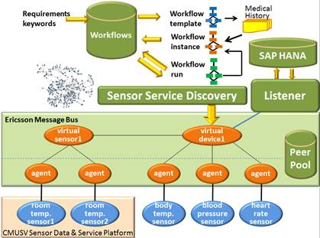
Research on SAP HANA One
CMUSV Research Project:
Sensor as a Service
Stream sensor data
Huge amount
Real-time big data analysis
Fast response
1. Jia Zhang, Bob Iannucci, Mark Hennessy, Kaushik Gopal, Sean Xiao, Sumeet Kumar, David Pfeffer, Basmah Aljedia, Yuan Ren, Martin Griss, Steven Rosenberg, Jordan Cao, Anthony Rowe, "Sensor Data as a Service - A Federated Platform for Mobile Data-Centric Service Development and Sharing", Proceedings of the 2013 IEEE International Conference on Services Computing (SCC), Jun. 27-Jul. 2, 2013, Santa Clara, California, CA, USA.
Notes:
CMUSV has developed a sensor data service platform, on top of the largest nation-wide campus sensor network developed at the Pittsburgh campus. In the past half year, with SAP sponsorship, CMUSV has successfully switched from NoSQL database to SAP HANA as our backend persistent layer, to support streaming sensor data.
The main driver is to support real-time big data analysis, over the streaming sensor data, in order to support community-oriented sensor service.

Slide 73
Teaching on SAP HANA California State University, Chico
Required MBA Business Intelligence Course
Business intelligence overview
Emphasis on models and business value of analytics
Mixed undergraduate and graduate students
SAP HANA Use Case Repository, Test Drives and Demos
In-class activity: Show video and small groups address questions
Discuss responses
SAP HANA University Alliances Curriculum
Learn to build tables and define views
Follow-up project with new data
SAP HANA Academy
Technical tutorials, for example, Working with Stored Procedures

Slide 74

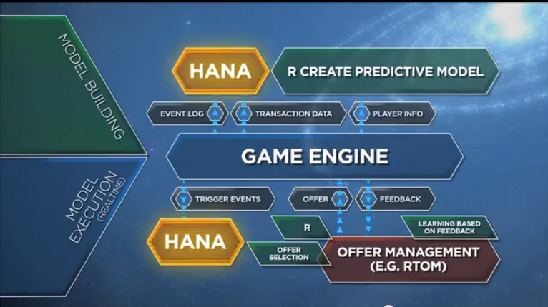
Watch the video about analytics at Bigpoint and answer the following questions:
What is the business value of the real-time analytics?
What data do you think are needed?
What does the analytics tool do?

Slide 75
Summary: In-Memory Database Platform for Big Data Migrate your App to SAP HANA One

Slide 76
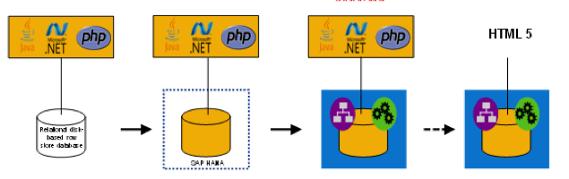
Migrating existing Project to HANA
Existing application
HANA as a database and some basic re-modeling of logic in HANA
Application Tier still processes and owns the business logic
Push down majority of the logic down into HANA
Application Tier becomes a thin UI / Security layer
All of the application logic is pushed down into HANA
Extremely low latency. User Interface is HTML5 and natively runs on top of HANA

Slide 77
Test & Demo - Developer Licenses – All partners
FREE
On-Premise Test & Demo Licenses
Partner Edge membership / SAP University Alliances Membership required
FREE
On-Demand Developer Licenses
2K
On-Premise Developer Licenses
Infrastructure costs apply
Partner Edge membership / SAP University Alliances Membership required

Slide 78
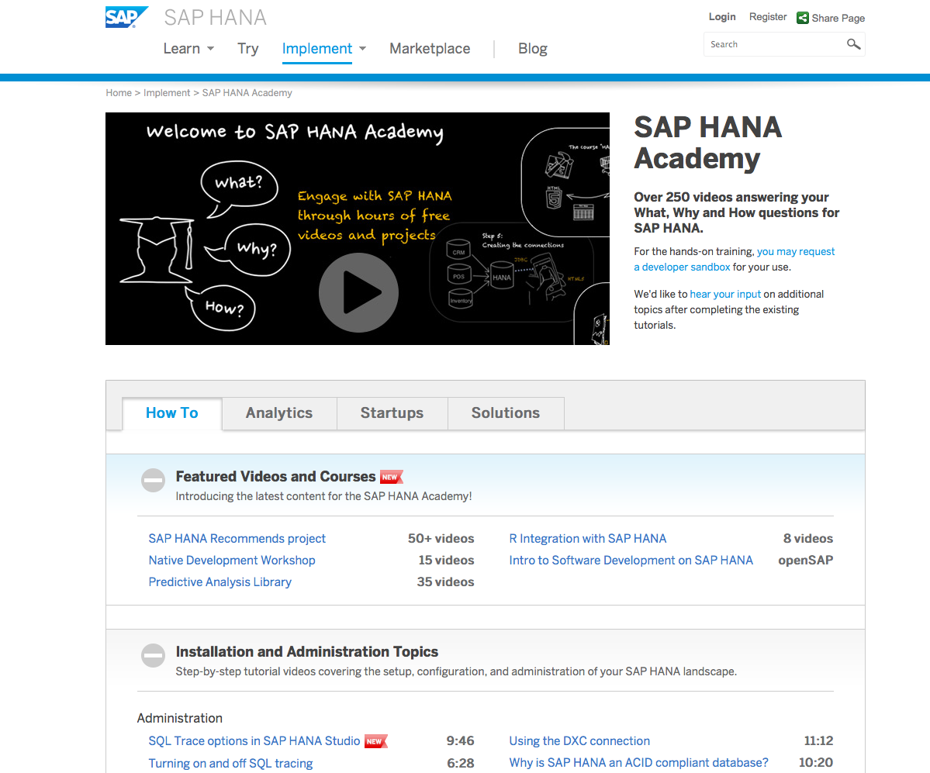
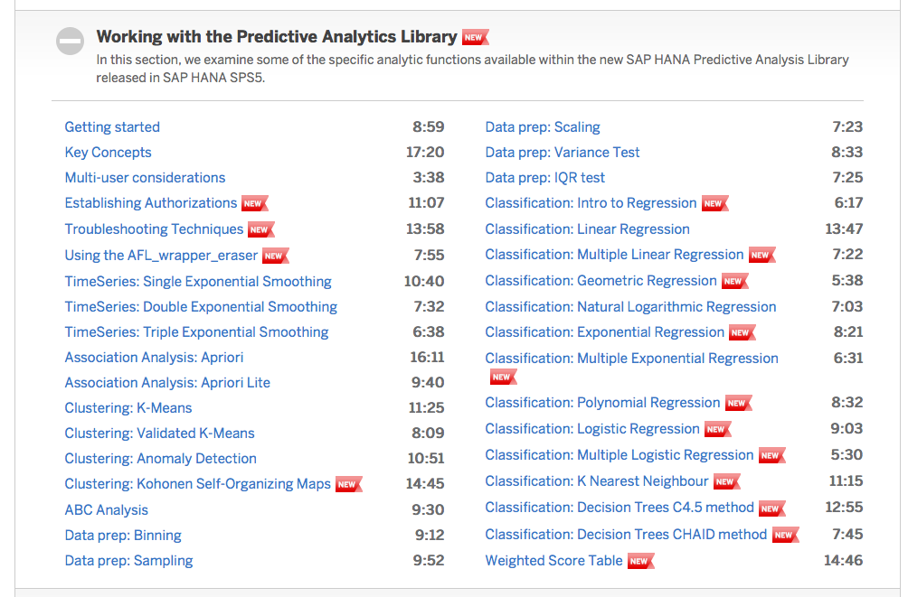
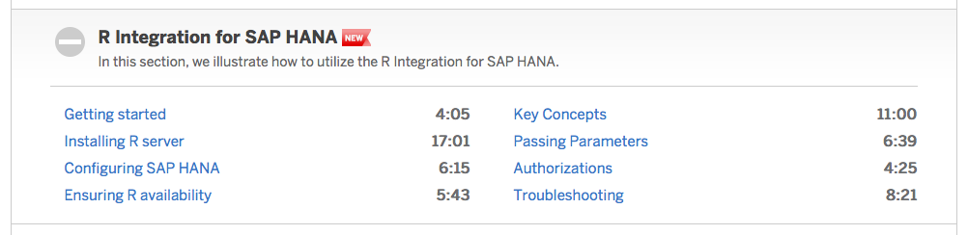
HANA Academy
URL: academy.saphana.com

Slide 79
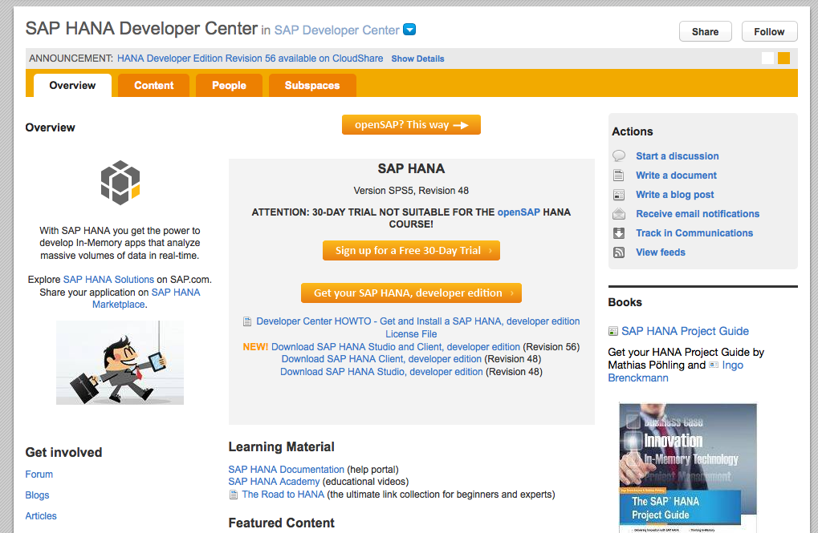
SAP HANA Developer Center
URL: http://scn.sap.com/community/developer-center/hana

Slide 80
Resources
Information
SAP HANA http://saphana.com
SAP HANA One http://cloud.saphana.com
FAQs: http://www.saphana.com/docs/DOC-2482
Quick Start Guide: http://www.saphana.com/docs/DOC-2437
Product reviews: https://aws.amazon.com/marketplace/review/product-reviews?asin=B009KA3CRY
Provisioning
SAP HANA One https://aws.amazon.com/marketplace/pp/B009KA3CRY
SAP HANA One Developer Edition http://scn.sap.com/community/developer-center/hana
Support
SAP HANA Academy: http://academy.saphana.com
SAP HANA Developer Center: http://developer.sap.com
SAP HANA One Community Support http://www.saphana.com/community/learn/cloud-info/cloud/hana-platform-aws
Blog
SAP HANA One - SAP HANA in a Light Bulb http://www.saphana.com/community/blogs/blog/2013/01/18/sap-hana-one--sap-hana-in-a-light-bulb

Slide 81
Thank you
Jordan Cao
Sr. Product Marketing Manager
Email: jordan.cao@sap.com
Uddhav Gupta
Sr. Solution Manager
Email: uddhav.gupta@sap.com

